Slide 1


Introduction to Digital Systems
EGR 226
Lecture_6
Dr. Nabeeh Kandalaft EGR226 Grand valley State University

Slide 2
Topic for today’s lecture
Interface a keypad with a MCU and scan a keypad to identify a key press
Describe the serial communication interfaces available on the MSP432
Setup the MSP432 for UART communication
Dr. Nabeeh Kandalaft EGR226 Grand valley State University

Slide 3
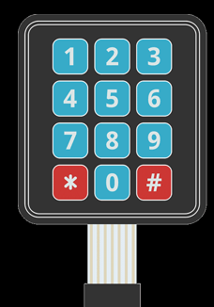
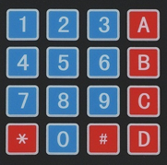
Keypad Input Device
Pressing a key connects a row and a column at the pushbutton site
ROWS
COLUMNS
Row1
Row2
Row3
Row4
Col1
Col2
Col3
Col4
Row1
Row2
Row3
Row4
Col1
Col2
Col3
Row1
Row2
Row3
Col1
Col2
Col3
Row4
Dr. Nabeeh Kandalaft EGR226 Grand valley State University

Slide 4
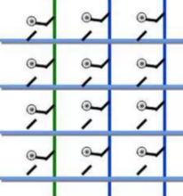
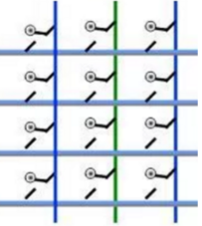
Reading a Keypad Input Device
Set up columns initially as inputs (high impedance, Z) to the MCU
Set up row as inputs with pull-up resistors (don’t leave floating)
Change one column (e.g., C0) to an output and set the value to LOW.
If a key is pressed in C0, it gets connected to LOW
Read R0-R3 to determine which one
Make the C0 High Z again, C1 LOW.
Read R0 to R3 again to give status of the second column of keys.
Low Z Z
Z Low Z
C0 C1 C2
C0 C1 C2
R0
R1
R2
R3
R0
R1
R2
R3
Value Read
Value Read
Dr. Nabeeh Kandalaft EGR226 Grand valley State University

Slide 5
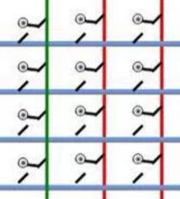
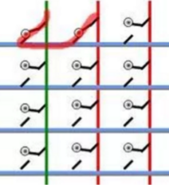
Reading a Keypad Input Device
Why set up columns as inputs (high impedance, Z),
why not just set them all as outputs and drive one low at a time?
If two keys are pressed in different columns, a short circuit would be created between output HIGH from one port pin to output LOW on another (bad, very bad)
Low Z Z
Low Z Z
C0 C1 C2
C0 C1 C2
R0
R1
R2
R3
R0
R1
R2
R3
Dr. Nabeeh Kandalaft EGR226 Grand valley State University

Slide 6
Basic Structure of a C Program
/* This program calls a subroutine that scans a 4x3 matrix keypad
* and returns a unique number for each key pressed. The character
* corresponding to the key pressed is printed to the CCS console.
* Port4 4,5,6 are connected to the columns
* Port4 0,1,2,3 are connected to the rows of the keypad.*/
#include "msp.h"
#include <stdio.h>
Void keypad_init (void); // prototype for GPIO initialization
uint8_t Read_Keypad (void); // prototype for keypad scan subroutine
void Print_Keys (void); // Print Key pressed
uint8_t num, pressed;
void main (void)
{
WDT_A->CTL = WDT_A_CTL_PW | WDT_A_CTL_HOLD; // stop watchdog timer
••• (insert your instructions here)
}
// header files with declarations and macro
//definitions used in the program

Slide 7
Rows: Port4 4.0, 4.1 4.2 4.3 Columns: Port4 4.4, 4.5, 4.6
uint8_t Read_Keypad(void)
{
uint8_t col, row;
for ( col = 0; col < 3; col++ )
{
P4->DIR = 0x00; // Set Columns to inputs
P4->DIR | = BIT ( 4+COL ); // Set column 1 to output
P4->OUT &=~ BIT ( 4+COL ); // Set column 1` to LOW
SysTick_delay (10); // Delay the while loop
row = P4->IN & 0x0F; // read all rows
while ( !(P4IN & BIT0) | !(P4IN & BIT1) | !( P4IN & BIT2) | !( P4IN & BIT3) );
if (row != 0x0F) break; // if one of the input is low, some key is pressed.
}
P4->DIR = 0x0F; // Set Columns to inputs
if ( col == 3)
return 0;
if (row == 0x0E) num = col + 1; // key in row 0
if (row == 0x0D) num = 3 + col +1; // key in row 1
if (row == 0x0C) num = 6 + col +1; // key in row 2
if (row == 0x07) num = 9 + col+1; // key in row 3
return 1;
}
Example Code
Dr. Nabeeh Kandalaft EGR226 Grand valley State University

Slide 8
Basic Structure of a C Program
int main (void)
{
WDT_A->CTL = WDT_A_CTL_PW | WDT_A_CTL_HOLD; // stop watchdog timer
keypad_init ( ); // Call initialization functions for functionality
while ( 1 )
{
pressed = Read_Keypad ( ); // Call Function to read Keypad
if ( pressed )
Print_Keys ( );
__delay_cycles(30000); // 10ms delay through the loop before reading keypad again
}
}
void keypad_init (void)
{
……… (insert your instructions here)
}
void Print_Keys ( void)
{
……… (insert your instructions here)
}
Dr. Nabeeh Kandalaft EGR226 Grand valley State University

Slide 9
Serial Communication

Slide 10


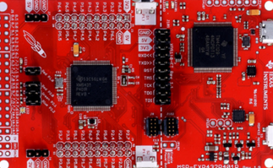
Serial Communication Between PC and Launchpad
0
1
1
0
1
0
0
0
1
1
1
Information passes between the computer and Launchpad via USB cable as 1’s and 0’s (bits)
Serial data transfer is when data is transferred one bit at a time,
one right after the other
Dr. Nabeeh Kandalaft EGR226 Grand valley State University

Slide 11
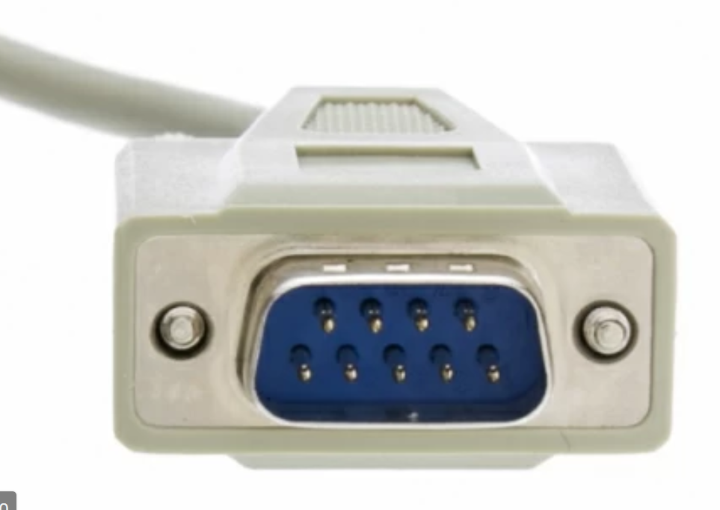
Serial Communications
Common configurations
possible to have DTE-to-DCE communication with as few as two wires:
TD and GND or RD and GND (half-duplex, one-way)
e.g., DCE is some industrial device
more common to have 3 wire (full-duplex, two-way) communication as shown
convention is to change labels on pins 2 and 3 on DCE
all other pins are unused
DTE
DCE
BCD
RD
TD
DTR
GND
DSR
RTS
CTS
RI
BCD
TD
RD
DTR
GND
DSR
RTS
CTS
RI
Dr. Nabeeh Kandalaft EGR226 Grand valley State University
Notes:
This is one of the most misunderstood areas of RS-232. DTE stands for Data Terminal Equipment, and DCE stands for Data Communications Equipment. DTE is typically either a dumb terminal or the serial port on a computer/workstation. DCE is typically a modem, DSU/CSU, or other piece of data communications equipment, hence the names. This is all most people really need to know about these terms. Where it gets confusing is when you start to talk about signal definitions and direction. For example, it's easy for someone to understand that when you transmit data, you send it out. However, when you talk in terms of DCE, it becomes an input signal. This is because the specification was written from the perspective of the DTE end of the link. Another example is the Receive Data signal is an input to DTE, but an output from DCE. Therefore, a straight through "one to one" cable is all that is necessary between a modem and a standard DTE serial port. However, if you want to connect two DTE ports together, you have to simulate the existence of the pair of DCE devices, typically modems that would normally be between the two DTE devices. This is where the null-modem device or cable comes in.

Slide 12
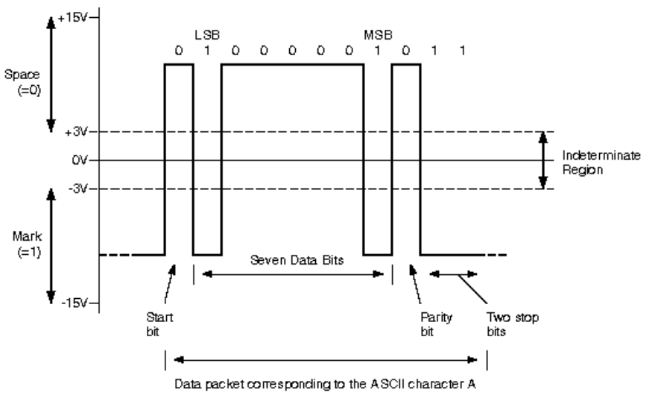
Serial Communications
The RS232 protocol uses two voltage level ranges to indicate
binary 1’s and 0’s.
The voltage range in between +3V and -3V represents an indeterminate logic level (provides noise immunity).
Logic 1
is indicated by a voltage < -3V,
Logic 0
is represented by a voltage > +3V
Dr. Nabeeh Kandalaft EGR226 Grand valley State University

Slide 13
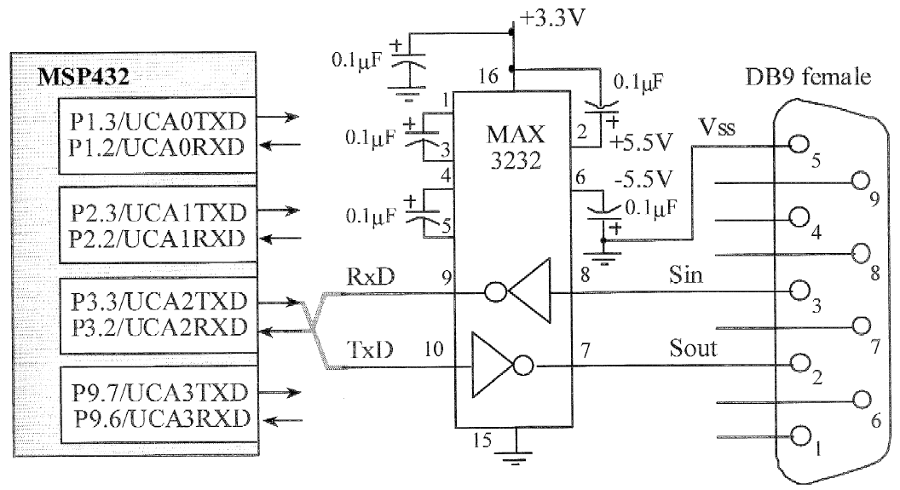
Serial Communications
The electrical levels used by RS232 do not match that of any standard digital interface.
RS232 communication requires some sort of interface circuit that will translate 0V and 3.3V to the bipolar voltage levels of RS232.
UCA0 is connected to a TM4C129 MCU that interfaces the USB port on the Launchpad
e.g., a MAX3232 IC device includes a built-in charge pump and voltage doubler to provide ±5V on Sout from a single +3.3V
From: Embedded Systems: Introduction to the MSP432 Microcontroller by James Valvano

Slide 14
Serial Communications
Data is transmitted one byte at a time on the TD line of either the DTE or DCE (which connects to the RD line of the other party).
The S bit is a start bit, and the T bit is a stop bit.
Data bits are transmitted LSB-first starting with bit 0 and ending with bit 7.
The stop bit is necessary since each transmission begins with a falling edge on TD to indicate the start bit.
Remains Idle until there is more data to send.
One Frame
3
.
3
V
S
e
r
i
a
l
p
o
r
t
S
t
a
r
t
b
0
b
b
b
3
b
4
b
5
b
6
b
T
idle
idle
1
2
7
0
V
TB

Slide 15
Serial Communications
The bit-period TB is a previously-agreed-upon duration that must be the same at the transmitter and receiver.
The number of bits per second, or 1/TB, is known as the baud rate.
The unit of bits-per-second is frequently abbreviated bps.
Common baud rates include 9600 bps, 19200 bps, 38400 bps, 57600 bps, and 115200 bps.
A 9600-bps rate is common in industrial equipment as it is a nice tradeoff between data rate and reliability (i.e., allowing for longer cable lengths, up to 500’ ).
One Frame
3
.
3
V
S
e
r
i
a
l
p
o
r
t
S
t
a
r
t
b
0
b
b
b
3
b
4
b
5
b
6
b
T
idle
idle
1
2
7
0
V
TB
Dr. Nabeeh Kandalaft EGR226 Grand valley State University

Slide 16
Serial Communications
Parity
“oddness or evenness” of an integer.
RS232 format can “steal” one data bit (ASCII needs 7 bits)
stolen bit can be used to indicate number of 1’s transmitted was odd or even, for very simple error detection.
For example, using the even parity scheme, all transmissions must have an even number of 1’s.
Transmitting binary 0110101 would require transmitting a parity bit of 0 since an even number of 1’s (4 of them) are present in the data.
Conversely, transmitting 0110100 would require transmitting a parity bit of 1.
Not used often because there are stronger methods of error checking
Dr. Nabeeh Kandalaft EGR226 Grand valley State University

Slide 17
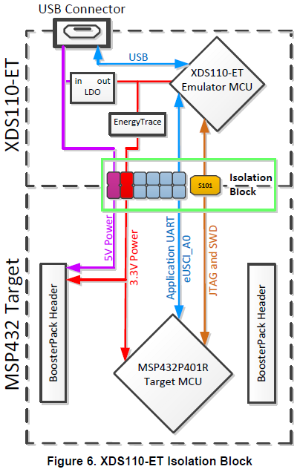
Launchpad Serial Communication
Serial receive (RX) and transmit (TX) bit streams
Connected to eUSCI_A0 on MSP432 (P1.2, P1.3)
Used to communicate between MSP432 program
and PC terminal emulator
Dr. Nabeeh Kandalaft EGR226 Grand valley State University

Slide 18
enhanced Universal Serial Communication Interface (eUSCI)
I2C
400kHz & up to 1MHz
4 hardware slave addresses supported with dedicated TX/RX interrupts
Byte counter for autonomous operation
UART
Enhanced baud rate generation
Auto baud rate detection
SPI
3 & 4-wire modes
Up to 14MBps
eUSCI A0
eUSCI A1
SPI, UART
eUSCI B0
SPI, I2C
eUSCI B1
Dr. Nabeeh Kandalaft EGR226 Grand valley State University
Notes:
MSP432 includes an eUSCI module. The eUSCI is a really flexible peripheral. It could also be called the Swiss Army knife of serial communication because the same module could be used to drive different communication interfaces such as I2C, UART and SPI. So the eUSCI can be split into two modules, the eUSCI A which is capable of driving the UART or the SPI communication and the eUSCI B is capable of driving the SPI and I2C communication. So starting off with UART, the eUSCI can drive multiple flexible UART configurations. It also introduces enhanced baud rate generation as well as baud rate detection. SPI communication on MSP 432 also supports both 3 and 4 wire modes and the SPI communication speed can be up to 14 Mbps. Lastly the I2C module on MSP432 can be used up to 400KHz and even 1MHz operating speed. We have also enhanced the I2C hardware module to include up to four hardware slave addresses supported with dedicated TX/RX interrupts.

Slide 19
UART
Enhanced Universal Serial Communication Interface A (eUSCI_A) Overview
The eUSCI_A module supports two serial communication modes:
UART mode
SPI mode
eUSCI_A Operation – UART Mode
In UART mode, the eUSCI_A transmits and receives characters at a bit rate asynchronous to another device.
Timing for each character is based on the selected baud rate of the eUSCI_A.
The transmit and receive functions use the same baud-rate frequency.
The recommended eUSCI_A initialization/reconfiguration process is:
1. Set UCSWRST.
2. Initialize all eUSCI_A registers with UCSWRST = 1 (including UCAxCTL1).
3. Configure ports.
4. Clear UCSWRST with software.
5. Enable interrupts (optional) with UCRXIE or UCTXIE.
Dr. Nabeeh Kandalaft EGR226 Grand valley State University

Slide 20
Character Format
The UART character format (see Figure 22-2) consists of a
start bit,
seven or eight data bits,
an even/odd/no parity bit,
an address bit (address-bit mode),
one or two stop bits.
O
n
e
f
r
a
m
e
3
.
3
V
S
e
r
i
a
l
p
o
r
t
S
t
a
r
t
b
0
b
b
b
3
b
4
b
5
b
6
b
AD
PA
SP
SP
1
2
7
0
V
Character Format

Slide 21
Asynchronous Transmission
Example 1:
Send 11010001₂ With one start bit, 8 data bits, and two stop bits
Start Bit
Data Bit 0
Data Bit 1
Data Bit 2
Data Bit 3
Data Bit 4
Data Bit 5
Data Bit 6
Data Bit 7
Stop Bit
Stop Bit
0
1
1
0
1
0
0
0
1
1
1
Example 2:
Send 00110001₂ with one start bit, 8 data bits, even parity, and two stop bits.
Start Bit
Data Bit 0
Data Bit 1
Data Bit 2
Data Bit 3
Data Bit 4
Data Bit 5
Data Bit 6
Data Bit 7
Stop Bit
Stop Bit
0
0
0
1
1
0
0
0
1
1
1
Dr. Nabeeh Kandalaft EGR226 Grand valley State University

Slide 22
There are five parameters must be configured correctly to establish
a basic serial connection.
Baud rate:
Baud rate is the number of symbols or modulations per second. Basically, the baud rate indicates how many times the lines can change state (high or low) per second.
Number of data bits:
The number of data bits transmitted is typically between 5 and 8,
the most common since an ASCII character is 7 bits for the standard set and 8 bits for the extended.
Parity:
The parity can be even, odd.
Stop bits:
The number of stop bits is most commonly configurable to either one or two
Endianess:
send the data in either LSB or MSB. Serial communication of ASCII characters is almost always LSB.
Notes:
. Since each symbol represents one bit, the bit rate equals the baud rate. For example, if the baud rate is 9600, there are 9600 symbols sent per second and therefore the bit rate is 9600 bits per second (bps) .
If the parity is configured to even and the number of 1’s is even then the parity bit is set zero. If the number of 1s is odd, the parity bit is set to a 1 to make the count even. If the parity is configured to odd, and the number of 1s is odd, then parity bit is set to 0. Otherwise, it is set to 1 to make the count odd. Mark and space parity mean that the parity bit will either be one or zero respectively for every transmission.

Slide 23
eUSCI Registers
Register Name | Register Function
UCAxCTLW0 (UCAx Control Word 0) | Control 0
UCAxMCTLW (UCAx Modulation Control Word Register | Modulation
UCAxBRW (UCAx Baud Rate Control Word) | Baud Rate
UCAxSTATW (UCAx Status) | Status
UCAxRXBUF (UCAx Receive Buffer) | Receive Register
UCAxTXBUF (UCAx Transmit Buffer) | Transmit Register
UCAxIE (UCAx Interrupt Enable) | Interrupt Enable
UCAxIFG (UCAx Interrupt Flag) | Interrupt Flags
UCAxIV (UCAx Interrupt Vector) | Interrupt Vector
Examples using ARM syntax
EUSCI_A0->CTLW0 = UCAxCTLW0
EUSCI_A0->BRW = UCAxBRW
EUSCI_A0->MCTLW = UCAxMCTLW
Dr. Nabeeh Kandalaft EGR226 Grand valley State University

Slide 24

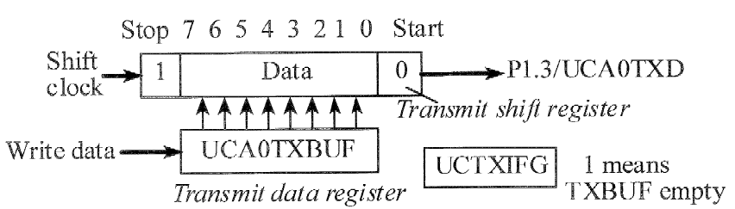
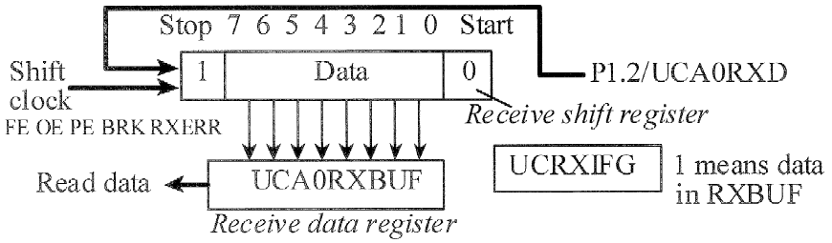
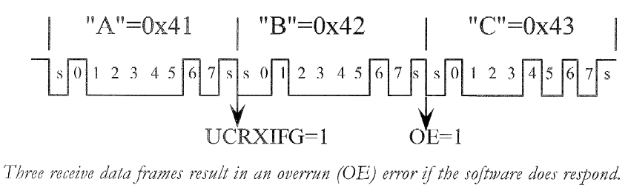
eUSCI In Universal Asynchronous Receive/Transmit
(UART) mode
Interactive
Tool 11.4
This must be high for two cycles
See http://users.ece.utexas.edu/~valvano/Volume1/E-Book/C11_SerialInterface.htm
Dr. Nabeeh Kandalaft EGR226 Grand valley State University

Slide 25
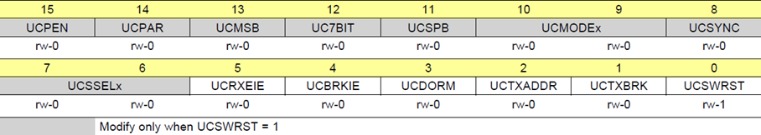
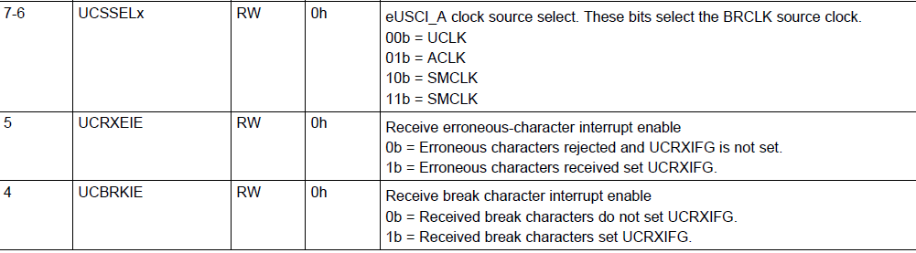
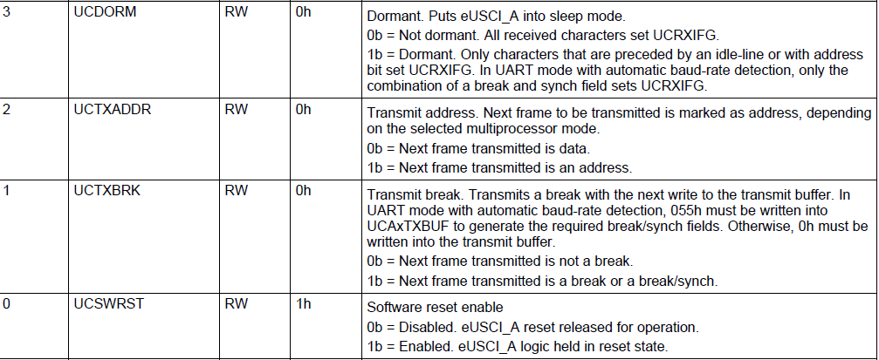
UCAxCTLW0 Register eUSCI_Ax Control Word Register 0

Slide 26
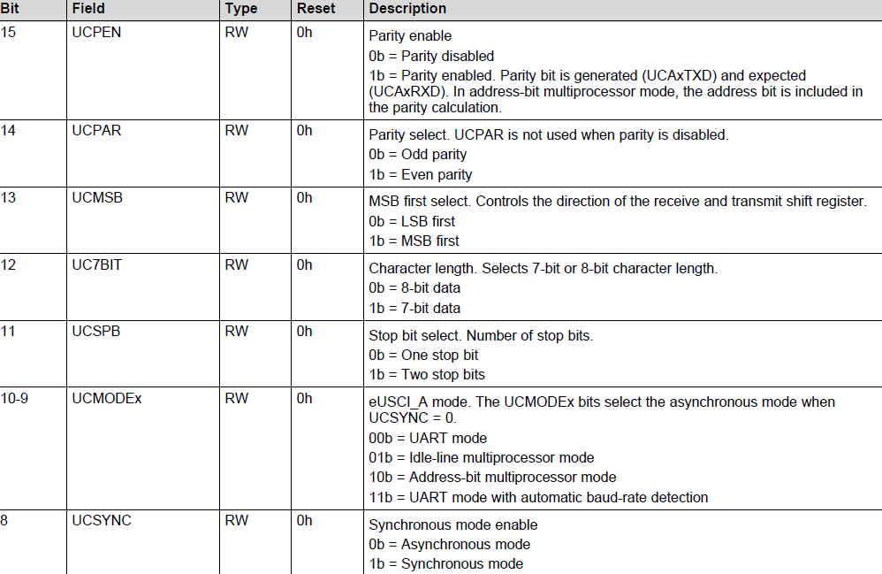
UCAxCTLW0 Register eUSCI_Ax Control Word Register 0

Slide 27
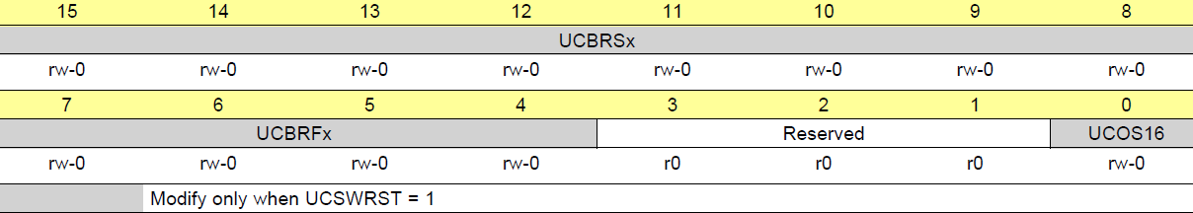
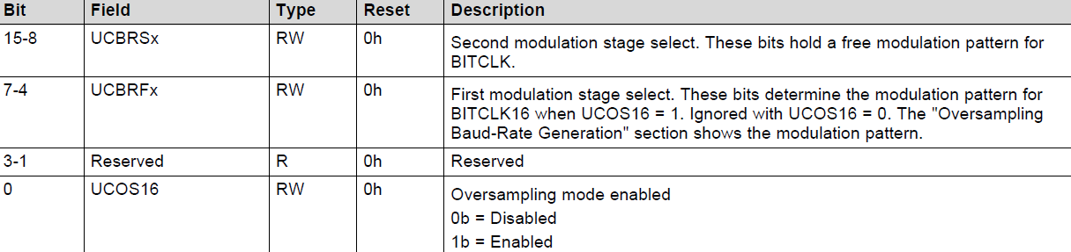
EUSCI_A0->MCTLW
Dr. Nabeeh Kandalaft EGR226 Grand valley State University

Slide 28
Setting a Baud Rate
For a given BRCLK clock source (Baud rate Clock Source), the baud rate used determines the required division factor N:
N = fBRCLK / baud rate
If N is equal or greater than 16, it is recommended to use the oversampling baud-rate generation mode by setting UCOS16.
Baud-rate settings quick set up
To calculate the correct settings for the baud-rate generation, perform these steps:
1. Calculate N = fBRCLK / baud rate if N > 16 continue with step3, otherwise step2
2. OS16 = 0 UCBRx = INT(N) continue with step 4
3. OS16 = 1 UCBRx = INT (N/16),
UCBRFx = INT ([(N/16) – INT (N/16)] × 16)
UCBRSx can be found by looking up the fractional part of
N = N - INT (N) Table 22-4
5. If OS16 = 0 was chosen, a detailed error calculation is recommended to be performed

Slide 29
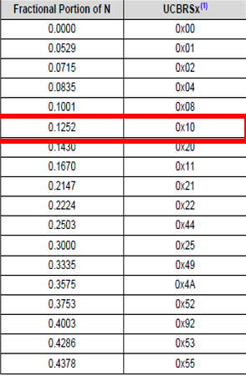
Example with UCOS16 enabled
Baud rate 9600 Frequency 12000000
N = 12000000/9600 = >1250
OS16 = 1
UCBRFx = INT( [ ( N / 16) – INT(N/16) ] x 16 )
= INT( [ (1250 / 16) – INT(1250/16) ] x 16 )
= INT( [ 78.125 - 78 ] x 16 )
= INT( [ 0 .125 ] x 16 )
= 2
Fractional portion = 0.125
UCBRSx = 0x10 User'sGuide Table 21-4:
Table 22-4.

Slide 30
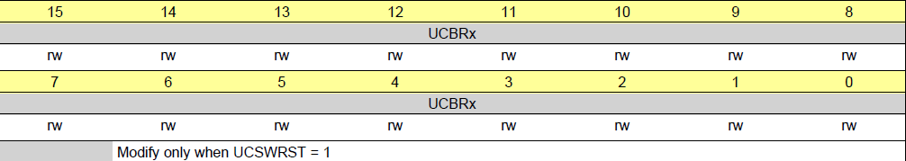
UCAxBRW Register
eUSCI_Ax Baud Rate Control Word Register
UCBRx = INT(N/16) = INT (12000000/(16*9600))
= 78

Slide 31
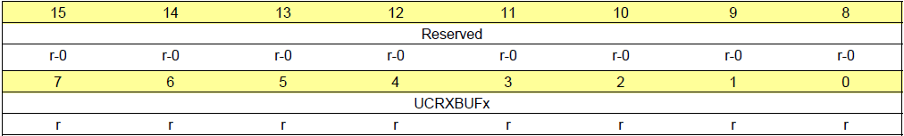
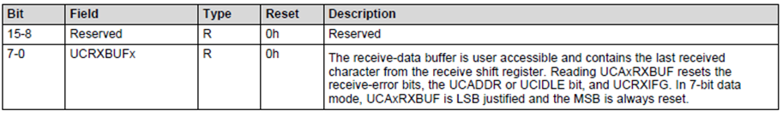
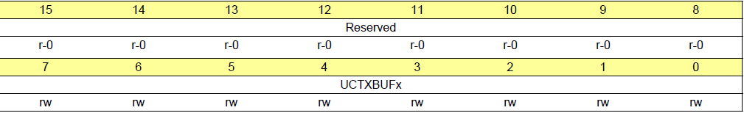
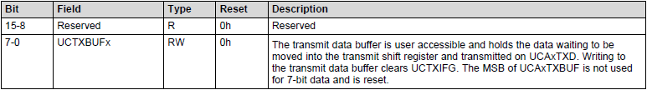
UCAxRXBUF Register ……eUSCI_Ax Receive Buffer Register
Figure 22-17. UCAxRXBUF Register
UCAxTXBUF Register …. eUSCI_Ax Transmit Buffer Register
Figure 22-18. UCAxTXBUF Register

Slide 32
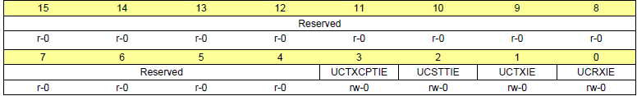
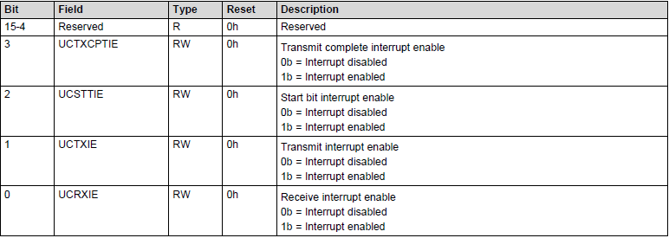
UCAxIE Register
eUSCI_Ax Interrupt Enable Register
Figure 22-21. UCAxIE Register
EUSCI_A0->IE |= BIT0; // Enable interrupt

Slide 33
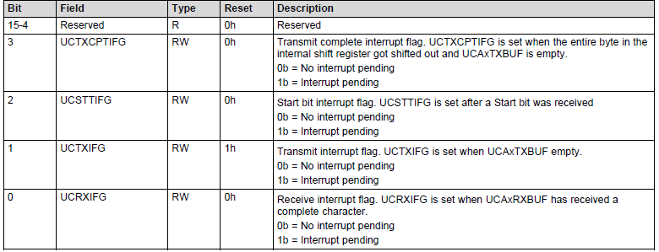
UCAxIFG Register …. eUSCI_Ax Interrupt Flag Register
Figure 22-22. UCAxIFG Register
EUSCI_A0->IFG &= ~BIT0; // Clear interrupt
while ( (EUSCI_A0 -> IFG&0x01) == 0); // wait till receiving end
while ( (EUSCI_A0 -> IFG&0x02) == 0); // wait till transmitting end

Slide 34
UCAxIE Register
eUSCI_Ax Interrupt Enable Register
Figure 22-21. UCAxIE Register
EUSCI_A0->IE |= BIT0; // Enable interrupt

Slide 35
eUSCI in UART mode
Flow chart for a simple driver for the MSP432 serial port
inChar ( ) waits for the receiver buffer flag to be set, then returns the byte
outChar ( ) waits until the previous byte has been transmitted, then sends the
byte in the buffer
InChar
OutChar
empty
Busy
UCRXIFG
UCTXIFG
0
Not empty
0
1
1
Idle
Read UCA0RXBUF
Write UCA0TXBUF
return
return
From: Embedded Systems: Introduction to the MSP432 Microcontroller by James Valvano
Dr. Nabeeh Kandalaft EGR226 Grand valley State University

Slide 36
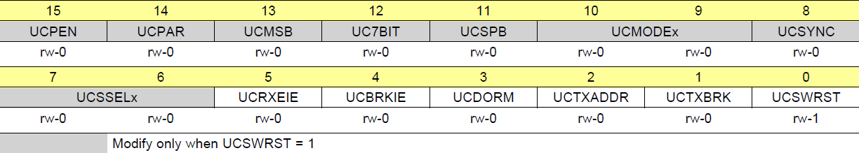
Example code for a simple driver for the MSP432 serial port
void UART_Init (void){
EUSCI_A0->CTLW0 = 0x0001; // hold the USCI module in reset mode
// bit15=0, no parity bits
// bit14=x, not used when parity is disabled
// bit13=0, LSB first
// bit12=0, 8-bit data length
// bit11=0, 1 stop bit
// bits10-8=000, asynchronous UART mode
// bits7-6=11, clock source to SMCLK
// bit5=0, reject erroneous characters and do not set flag
// bit4=0, do not set flag for break characters
// bit3=0, not dormant
// bit2=0, transmit data, not address (not used here)
// bit1=0, do not transmit break (not used here)
// bit0=1, hold logic in reset state while configuring
EUSCI_A0->CTLW0 = 0x00C1; FREQUENCY MHz Baud Rate is 115200
EUSCI_A0->BRW = 26; // UCBR = baud rate = int(N) =26 = clock/baud rate = 26.0417
EUSCI_A0->MCTLW &= ~ 0xFFFE; &=~BIT0; // clear first and second modulation stage bit fields,
P1SEL0 |= 0x0C;
P1SEL1 &= ~ 0x0C; // configure P1.3 and P1.2 as primary module function
EUSCI_A0->CTLW0 &= ~ 0x0001; // enable the USCI module
EUSCI_A0->IE &= ~ 0x000F; // disable interrupts
}
// Wait for new serial port input, then return byte in receive buffer
char UART_InChar (void){
while((EUSCI_A0->IFG&0x01) == 0);
return((char) (EUSCI_A0->RXBUF));
}
// Wait for last byte to be sent, then output character by placing in transmit buffer
void UART_OutChar (char data){
while((EUSCI_A0->IFG&0x02) == 0);
EUSCI_A0->TXBUF = data;
}
UCAxCTLW0 Register
eUSCI_Ax->CTLWO = 0X0001
UCA0CTLW0 |= UCSWRST;
Dr. Nabeeh Kandalaft EGR226 Grand valley State University

Slide 37
RS232

Slide 38
Example Code for Keypad Scan
char keypad_getkey(void) { // assumes port 4 bits 0-3 are connected to rows
int row, col; // bits 4,5,6 are connected to columns
const char column_select[] = {0x10, 0x20, 0x40}; // one column is active
// Activates one column at a time, read the input to see which column
for (col = 0; col < 3; col++) {
P4->DIR &= ~0xF0; // 1 disable all columns
P4->DIR |= column_select[col]; // 2 enable one column at a time
P4->OUT &= ~column_select[col]; // 3 drive the active column low
__delay_cycles(10); // 4 wait for signal to settle
row = P4->IN & 0x0F; // 5 read all rows
P4->OUT |= column_select[col]; // 6 drive the active column high
if (row != 0x0F) break; // 7 if one of the input is low, // some key is pressed.
}
P4->OUT |= 0xF0; // 8 drive all columns high before disable
P4->DIR &= ~0xF0; // 9 disable all columns
if (col == 3)
return 0; // 10 if we get here, no key is pressed
// 10 gets here when one of the columns has key pressed,
// check which row it is
if (row == 0x0E) return col + 1; // key in row 0
if (row == 0x0D) return 3 + col + 1; // key in row 1
if (row == 0x0B) return 6 + col + 1; // key in row 2
if (row == 0x07) return 9 + col + 1; // key in row 3
return 0; // just to be safe
}

